Slide 1
Introduction to Python
Restricted, Sensitive (Normal)
Ng Wee Kiat Jeremy, PhD
Anatomical Molecular Laboratory (ATOM)
Singapore General Hospital

Slide 2

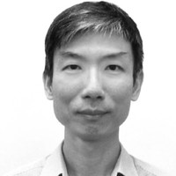
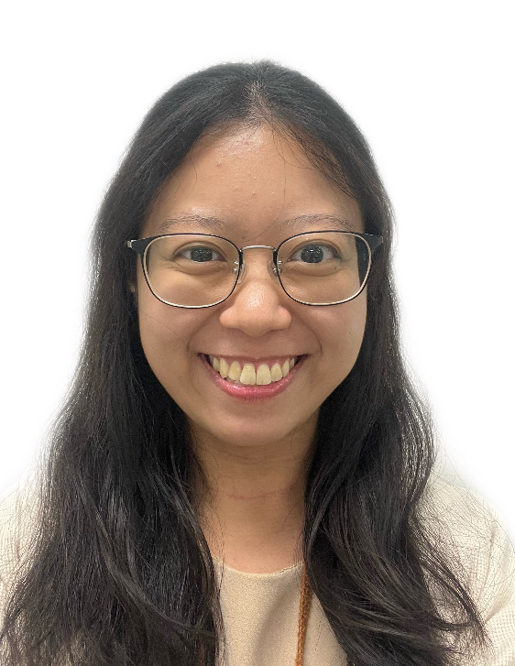
Course Facilitators
Jeremy Ng
Chan Chee Seng
Natalia Fernandez
Lakshmi Alagappan
Senior Bioinformatician @ ATOM
Senior Bioinformatician @ ATOM
Executive @ Artificial Intelligence & Automation (AIA)
Research Fellow @ NCCS)

Slide 3
Course Overview- Day 1
Day 1 | 09:00 | Information exchange on the internet | What exactly is the internet? How is information exchanged on the internet? Why APIs?
 | 09:25 | Getting started | What is the dataset that we are working with? Why do we need to use an environment manager such as conda?
 | 10:05 | Using libraries to extend Python | How do I make use of what others have built in their libraries? What are the best practices in importing libraries? How do I know what a library provides?
 | 10:35 | Break
 | 10:45 | Variables as data containers in programming | How do we store information in Python? How do we modify data?
 | 11:20 | Introduction to data types | What are data types? Why does the data type matter? How do we work with text in Python?
 | 12:00 | Lunch Break
 | 13:00 | Performing your first API query | How can we perform our first API query? How do we interact with the response we get back from the API?

Slide 4
Course Overview- Day 1
 | 13:40 | Manipulating a collection of records | What are some common data types used to store collections of items? How can we manipulate the data in these collections?
 | 14:30 | Working with numeric and time data in Python | What are the different numeric types in Python? How can we work with date and time in Python? How can we properly format our numeric data?
 | 15:00 | Break
 | 15:30 | How do I compare? | How can we make comparisons between values in Python? Truey-ness in Python - what do we mean by True and False?
 | 16:00 | Deciding an appropriate course of action in my program flow | How can we make a program decide how to process an input?
 | 17:00 | Wrap-up | What have we accomplished so far in our walk with the API response? What are we going to do tomorrow?
 | 17:10 | Finish

Slide 5
Course Overview – Day 2
Day 2 | 09:00 | Taking a jog down memory lane | What are we trying to do by the end of the session? What have we covered in the session yesterday?
 | 09:40 | Building your own reusable code with functions | How do we create reusable codes in our program? What are some best practices in writing reusable codes?
 | 11:00 | Break
 | 11:10 | Managing user and code failures | How are errors handled in Python? What are some common coding practices to handle errors in programming?
 | 12:00 | Lunch Break

Slide 6
Course Overview – Day 2
13:00 | Automation using control functions | How do we perform repetition without repetition
14:10 | Importing and exporting your results | How do we read and export results between hard disk and Python memory? What are some common file formats?
15:00 | Break
15:30 | Putting it altogether | Are you ready to write your first Python code to work with the API of your choice?
16:40 | Next steps | What else can I do next? How should I go about improving my Python skills?
17:00 | Finish

Slide 7
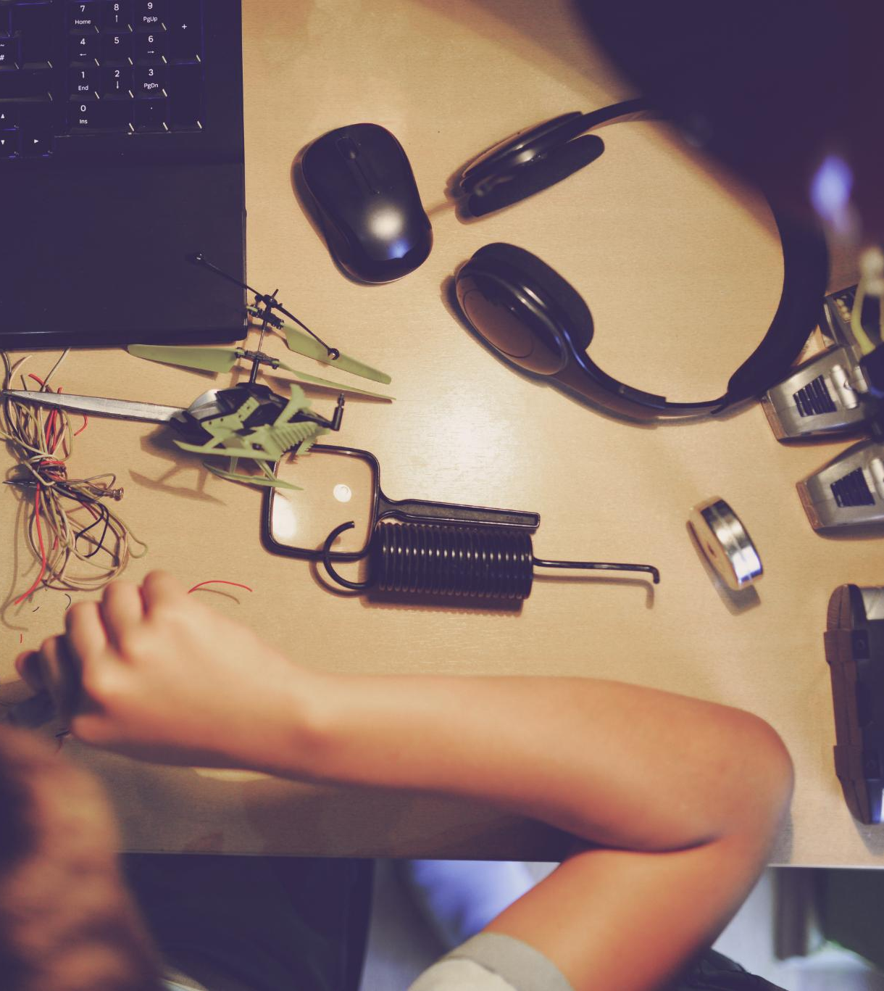
Maximising Your Learning
Engage actively by attempting the hands-on exercises
Ask questions
Review and apply concepts after the workshop

Slide 8
Introduction to programming

Slide 9
What is computational thinking?
Break down complex problems into smaller parts (Decomposition)
Find patterns and similarities (Pattern Recognition)
Focusing on important details while ignoring the irrelevant information (Abstraction)
Creating step by step solutions (Algorithm Design)

Slide 10
A peek into the minds of programmers
Requirements
Write code
Run code
Check output
Coding is an iterative process

Slide 11
Programming – what is it?
The act of giving instructions the computer to perform specific tasks
Instructions need to be precise as computers cannot think for themselves

Slide 12
Examples of programming languages
Fortran – numerical analysis
C – system programming
PERL – system administration, general programming
De facto for bioinformatics programming in the early 2000s
Python – general programming

Slide 13
Decisions, decisions, decisions
Languages have different strengths & weaknesses
Some languages occupy specific niches. For instance:
R: Statistical computing
Fortran: Numeric computing
C/C++: High-performance computing
Others are more general purpose, like Python
Notes:
Some considerations:
Implementation speed (developer experience)
Execution speed (compute performance)
Safety (memory safety)

Slide 14

Python: A gentle introduction
Open source free software
Developed by Guido van Rossum in the 1990s
Easy to learn and read
Straight forward English-like syntax
Designed to be intuitive for beginners
Use for scripting, web site, data analytics, and many more

Slide 15
Strengths and weaknesses of Python
Strengths | Weaknesses
Easy to read | Sensitive to indentation
Rich ecosystem of packages to support wide range of use case | Can be slow when working with large data
Good documentation and active developer community | Lack of static type checking can mean codes can fail silently
Actively maintained and developed | Some lack of compatibility between Python versions

Slide 16
The development environment: IDEs
Software tools designed for software development
Popular ones include Visual Studio Code (VSC), PyCharm and IDLE
Extensions allow language specific features

Slide 17
Let’s jump in!

